Slide 1

The Democratization of South Korea: A History of Freedom
presented by Koffi Bi Blin Modeste J.

Slide 2

Program
* | Historical context
1 | Movement for democracy
2 | Repression and resistance
3 | Transition to democracy
4 | Conclusion

Slide 3
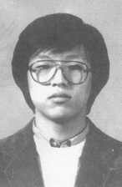
Historical context
South Korea has undergone a turbulent history, marked by the Japanese invasion, post-war division and authoritarian regimes supported by the United States. After the Korean War in 1953, the country was ruled by authoritarian governments that favored rapid industrialization but suppressed opposition. In the 1980s and 1990s, society demanded more freedoms and rights, influenced by events such as the death of student activist Park Jong-chul in 1987. International pressure, notably from the UN and Amnesty International, contributed to democratization.

Slide 4
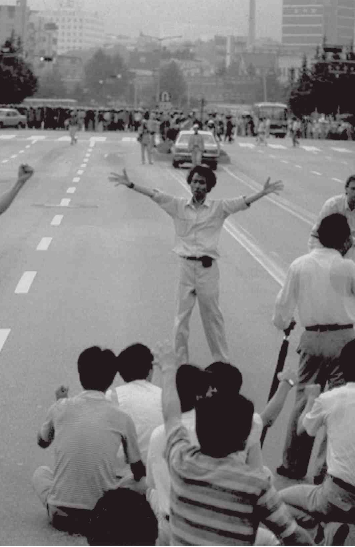
Movement for democracy
The 1980s and 1990s in South Korea were marked by a series of social and political movements in favor of democracy. Students played a central role in organizing massive protests and occupying campuses to make their demands heard. Workers have also struck regularly to demand better pay and working conditions.
Religious groups, notably Christian churches, have been key players in this struggle for democracy. They provided a space for citizens to gather, discuss and plan collective actions. Priests and pastors have often found themselves on the front lines, taking considerable risks to defend the rights of their faithful.

Slide 5
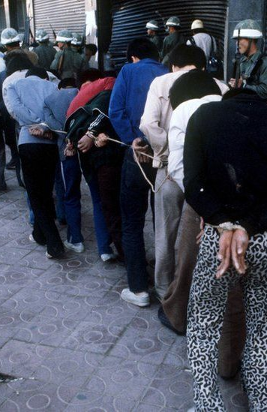
Repression and resistance
The South Korean government has responded with brutality and repression to the demand for democracy. Protests have often been dispersed by force, with mass arrests and detentions. The media suffered severe censorship and many journalists were persecuted for covering the events. The national security law was invoked to justify the arrest of those suspected of supporting the democracy movement.
Despite this repression, activists and citizens persevered. Hunger strikes were launched to protest arbitrary arrests and torture in prison. Religious groups opened their doors to protesters seeking refuge. Students organized peaceful marches to demand the release of political prisoners. This resistance ultimately led to the transition to democracy in South Korea.

Slide 6
Transition to democracy
South Korea's transition to democracy was a complex process spanning several decades. The 1980s were marked by the emergence of social and political movements challenging the military regime in place since the 1960s. Massive student demonstrations, strikes and religious mobilizations played an essential role in this struggle.
However, it was in the 1990s that democracy finally took root. International pressures played a determining role, notably with the organization of the 1988 Summer Olympics in Seoul. Economic and political sanctions imposed by the United States also weighed in the balance. The efforts of South Korean political forces, notably the Democratic Party of Korea, have been crucial in advancing the democratization process.

Slide 7
Conclusion
In summary, South Korea underwent a remarkable evolution from an authoritarian regime to a democracy during the 1980s and 1990s. We watched the social and political movements emerge, as well as the repressions and resistance that resulted. . This transition to democracy has been influenced by national and international actors.
South Korea's democratization illustrates the capacity of citizens to work for political change. It also reminds us that democracy is precious and requires lifelong commitment to its preservation and strengthening

Slide 8
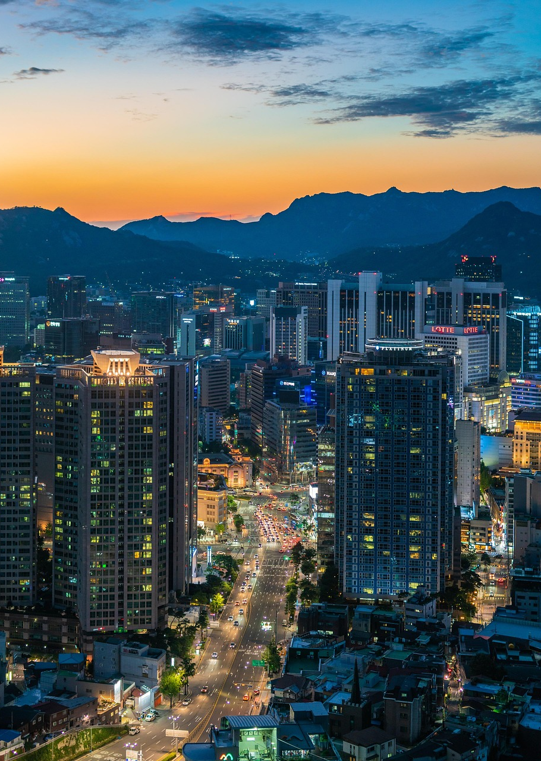
Thank you for your attention
Koffi bi blin Modeste Junior
Modeste-junior.koffi@iit.ci
010 – 6696 - 7081

